Slide 1

Let’s learn about
Public Speaking Anxiety

Slide 2

What is Public Speaking Anxiety
Public Speaking Anxiety is the fear or nervousness experienced when speaking in front of an audience.
It’s one of the most common types of social anxiety, affecting people’s ability to communicate confidently and effectively.

Slide 3



How Do You Feel?
before we continue, can you tell me how you feel when you have to speak in front of people?

Slide 4

Data Overview
The dataset aims to understand how different factors (confidence, preparation, and feedback preferences) influence public speaking performance and anxiety.
These insights can help design AI feedback systems and training programs that address real-world speaker needs.

Slide 5


Important Columns
Speaking_Type
Prep_Method
Profession
Speaking_Freq
Confidence_Score
Biggest_Fear
Anxiety_Management
Audience_Engage
Engaging_Factors
Improvement_Area

Slide 6


Project Workflow
Handled missing values, encoded categorical data, and normalized numerical features.
Conducted exploratory data analysis (EDA) using Pandas, Seaborn, and Matplotlib.
understand scope and topic
Python
Understand Data
SQL Queries
Power bi
Used SQL to explore tables and understand column structures.
Loaded the cleaned dataset into Power BI.
Built an interactive dashboard to visualize insights

Slide 7
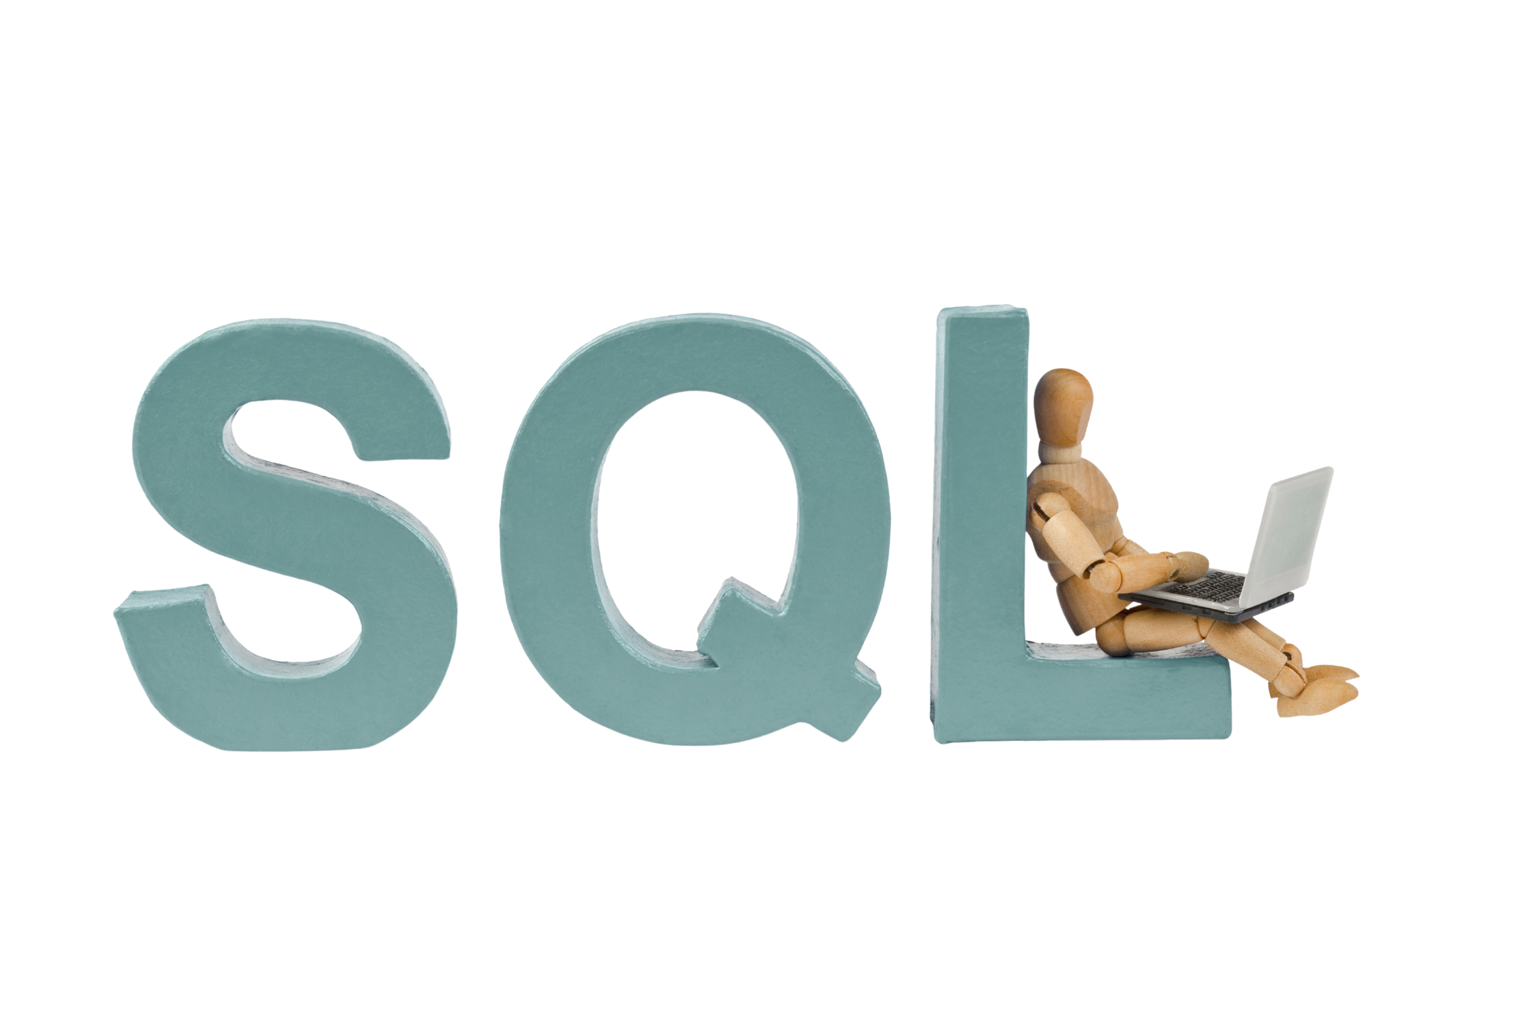

Slide 8
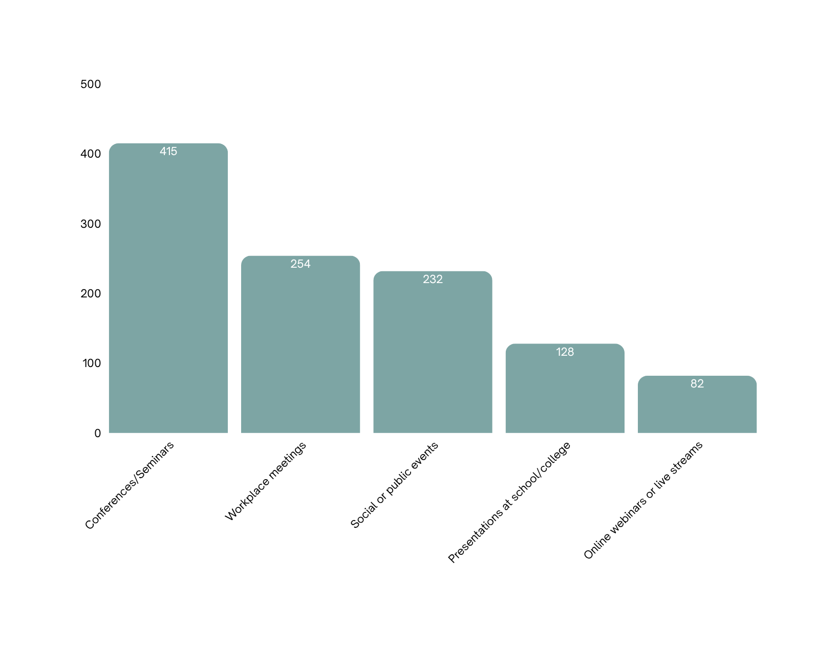
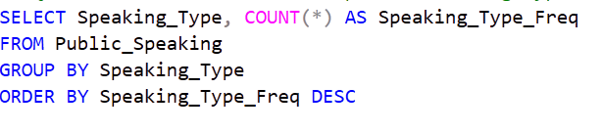
Public Speaking Types

Slide 9
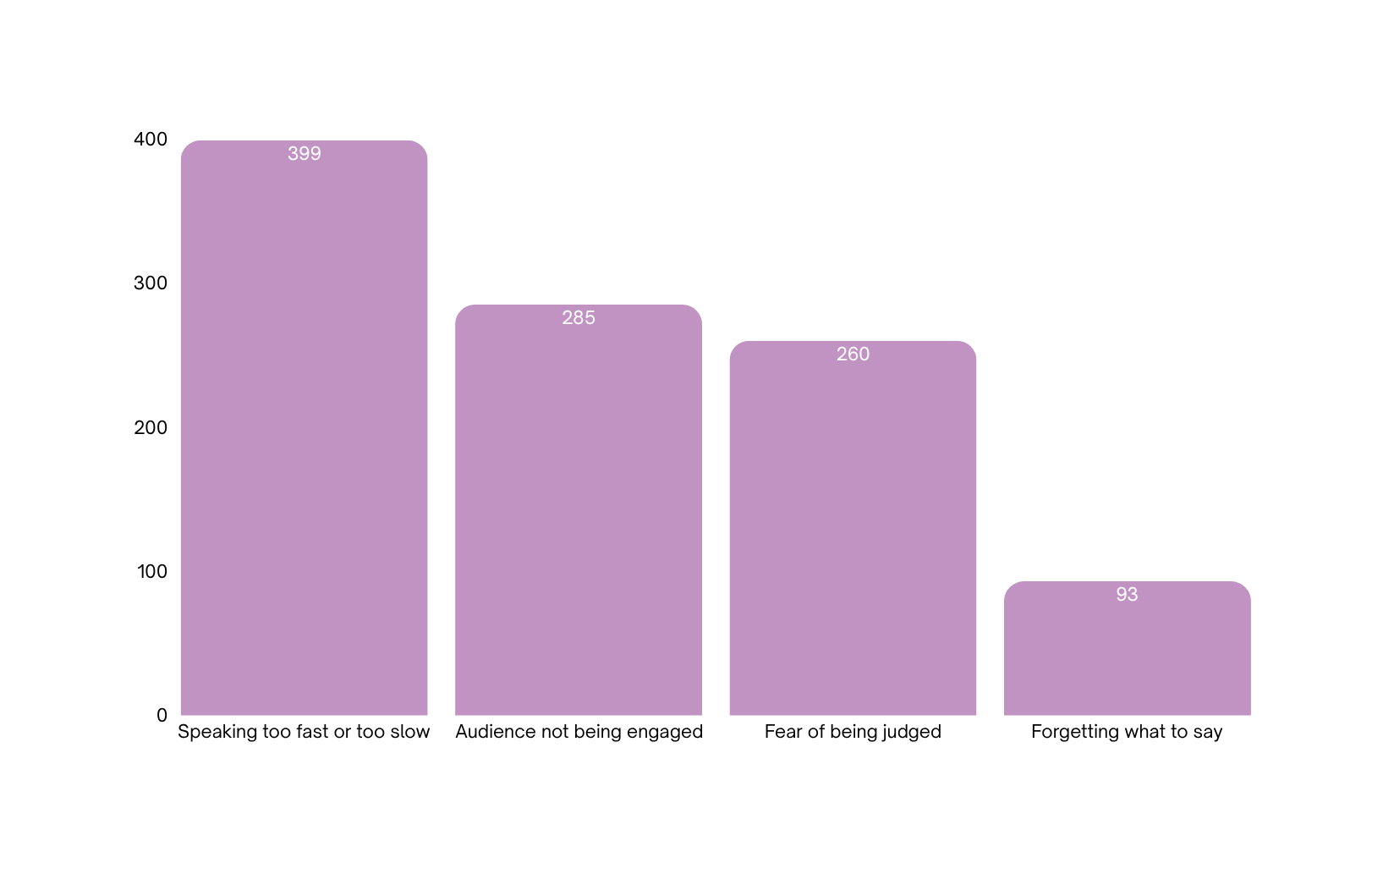
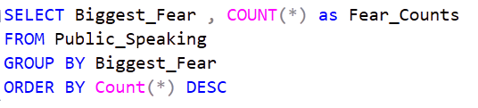
Public Speaking Fears

Slide 10
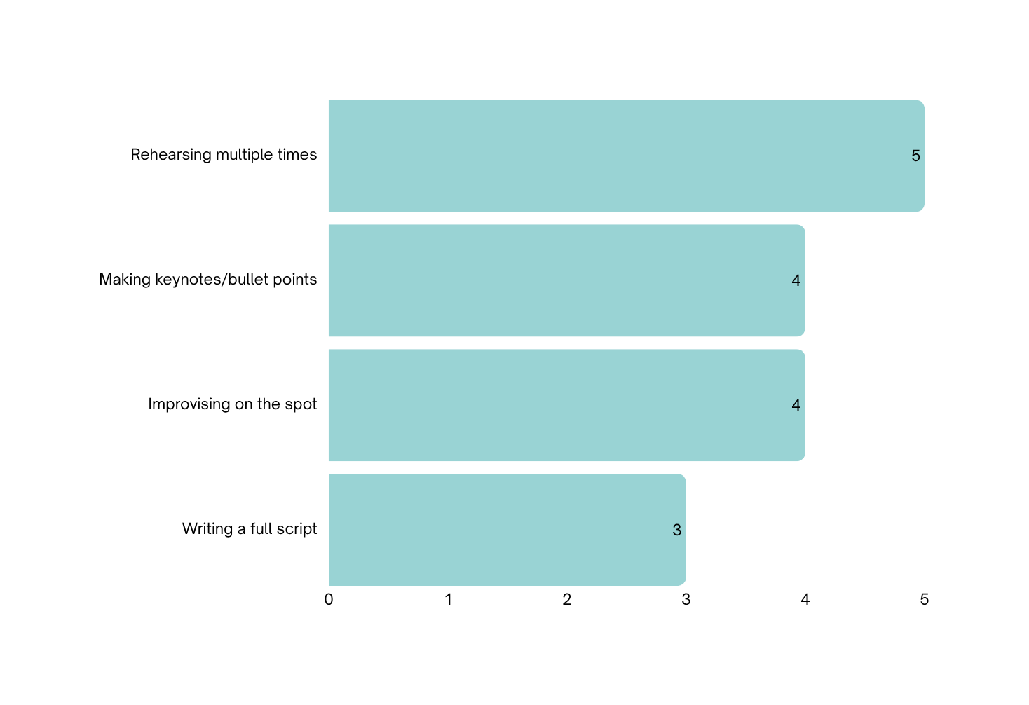
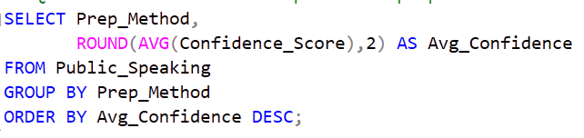
Relationship Between Preparation Methods and Confidence Levels

Slide 11
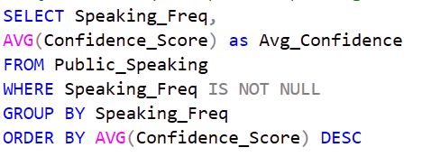
Does Frequent Public Speaking Increase Confidence?

Slide 12

SQL Summary
What I Used
What I Gained
SELECT statements to extract relevant columns.
Understood dataset relationships and trends.
Applied GROUP BY and ORDER BY to summarize and organize data.
Identified key variables for deeper analysis
Prepared and exported the dataset structure for further cleaning in Python.”
Calculated metrics using AVG() and COUNT()

Slide 13


Slide 14
Python summary
What I Used
What I Gained
Cleaned and prepared the dataset
Learned how to handle and clean unstructured or messy data.
Performed exploratory data analysis (EDA) to understand patterns and relationships.
Improved my ability to transform raw data into a usable format.
Enhanced skills in visualizing insights using Python libraries.
Visualized insights using Matplotlib and Seaborn.

Slide 15


Slide 16
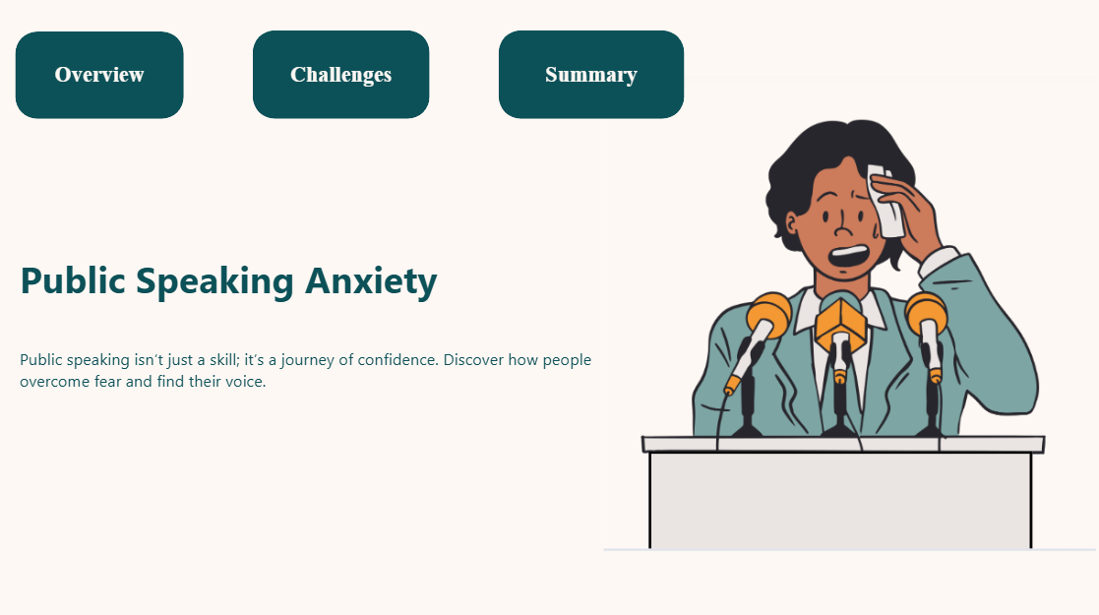

Slide 17
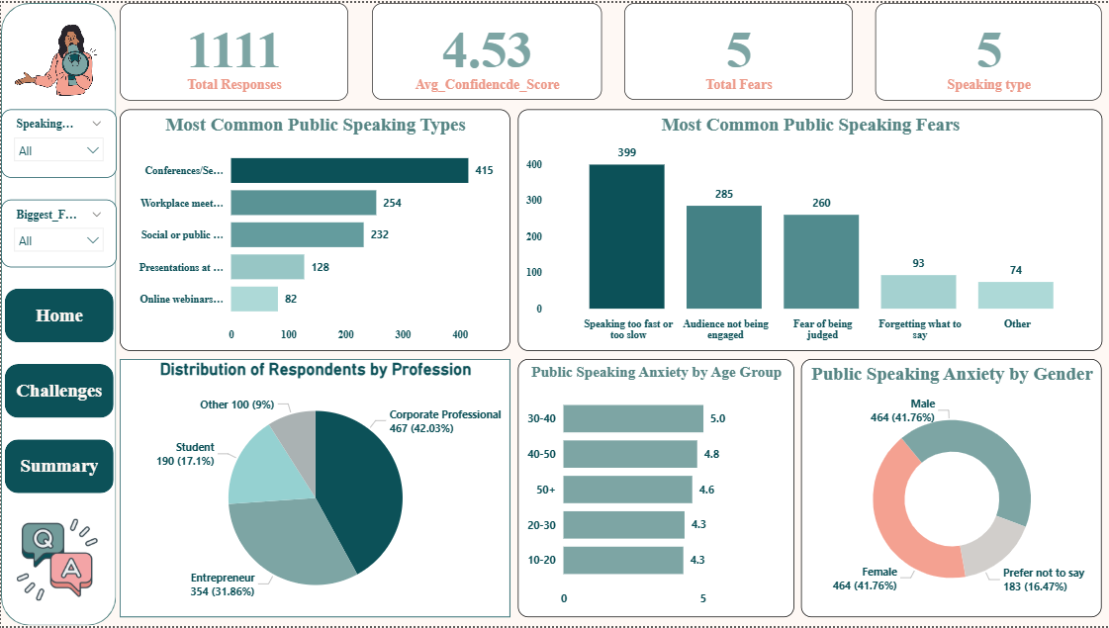

Slide 18
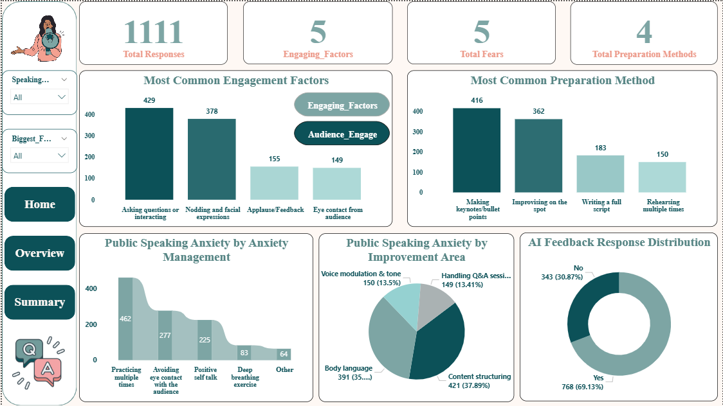

Slide 19
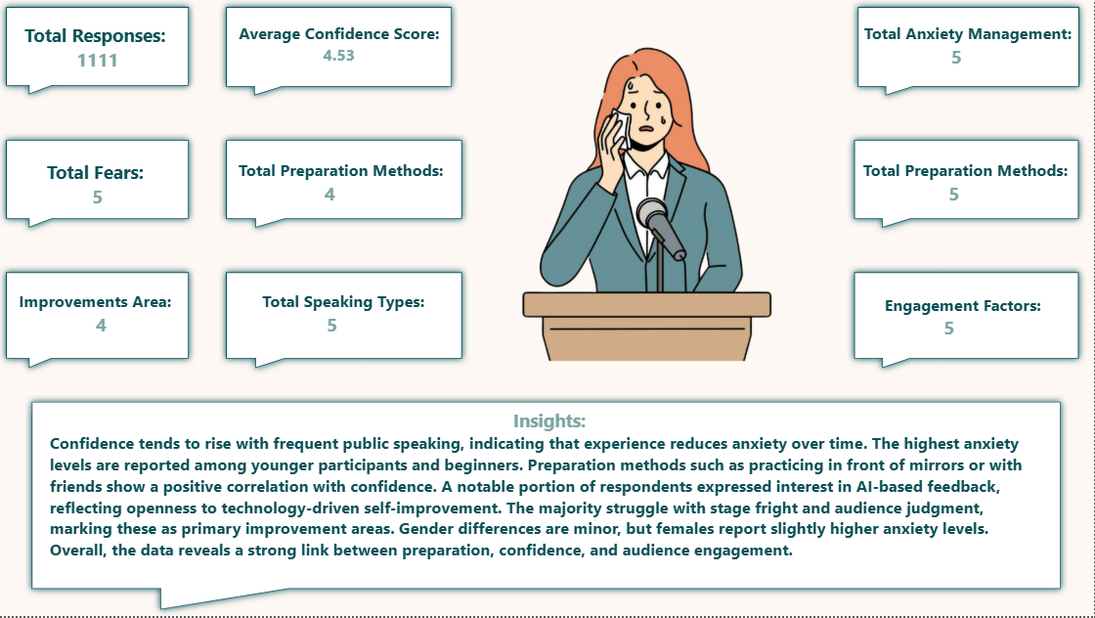

Slide 20

Target Audience
Students & Learners
Professionals
Trainers & Coaches
Researchers
AI Developers

Slide 21


What I Learnet
Handling unclean and inconsistent data before analysis.
Combining results from SQL, Python, and Power BI into one cohesive story.
Managing data interpretation — translating numbers into meaningful conclusions.
Balancing technical accuracy with visual storytelling for presentation clarity.

Slide 22


Conclusion
The analysis revealed that experience and preparation play a major role in building confidence and reducing anxiety in public speaking.
Frequent practice and effective preparation methods—such as rehearsing with friends or using AI feedback—lead to better audience engagement.
The majority of participants face fear of judgment and stage fright, highlighting the need for emotional and skill-based support.
There is growing interest in AI-based feedback tools, showing potential for technology to support communication skill development.
Overall, the study emphasizes that public speaking confidence can be developed through awareness, preparation, and constructive feedback.

Slide 23
Thanks for listening!
The End!

Slide 24






























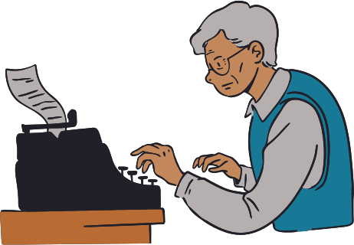

Resource Page

